Slide 1

Quantum Computing
Matthew Paredes

Slide 2
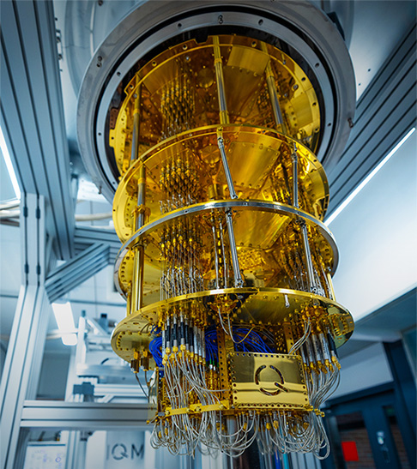
What is a quantum computer?

Slide 3
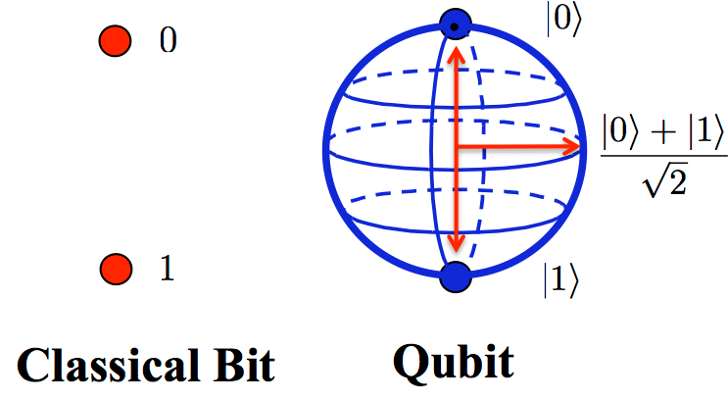
Qubits

Slide 4
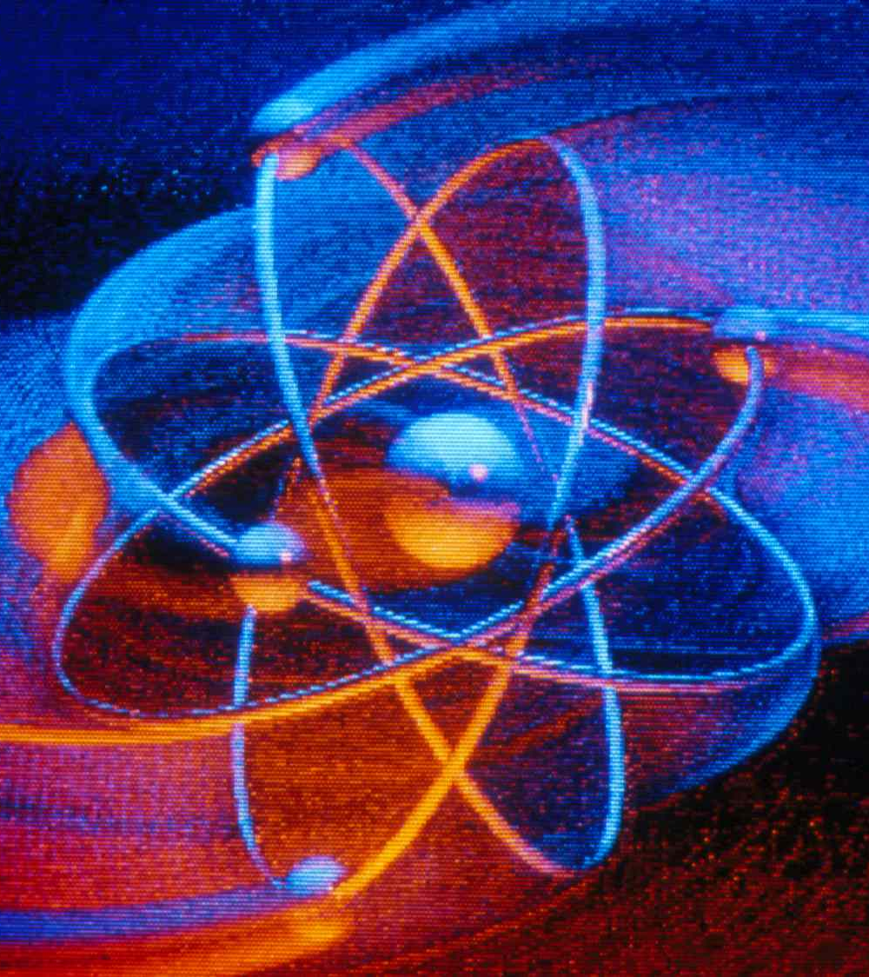
Controlling the spin

Slide 5
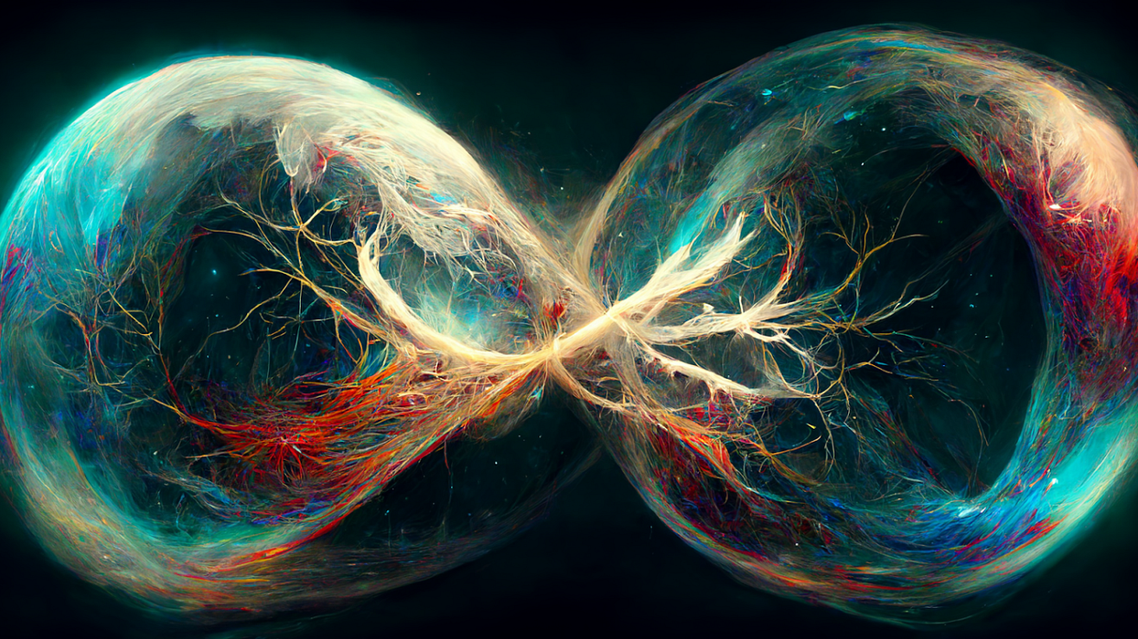
Quantum entanglement

Slide 6


Slide 7
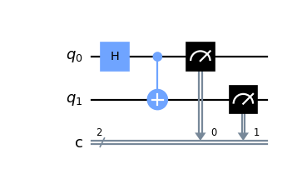
Quantum circuits

Slide 8
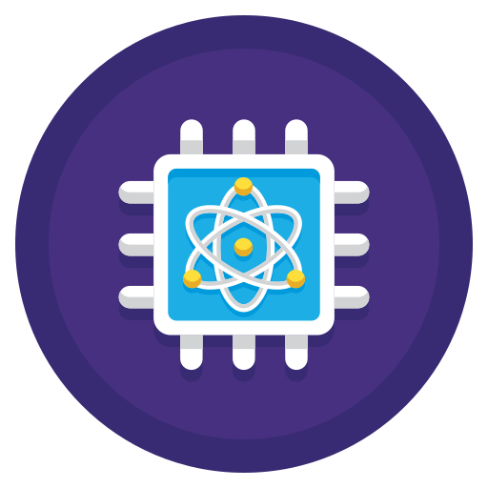
What does all this mean?

Slide 9
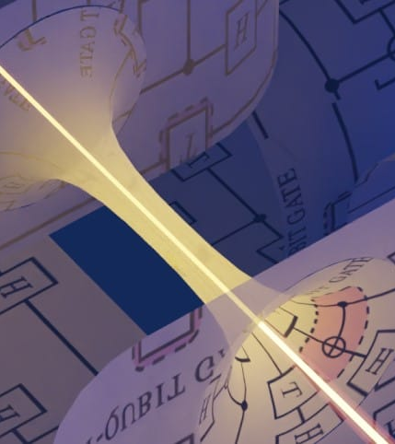
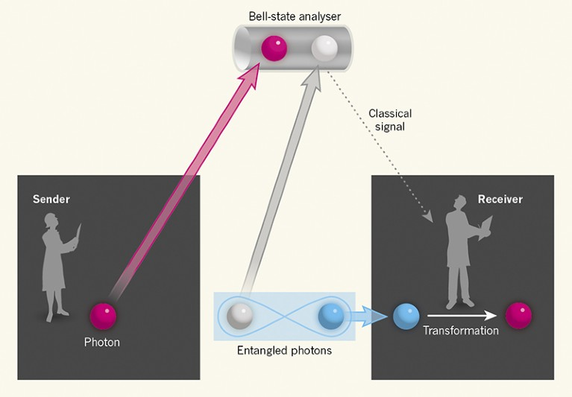
Quantum teleportation

